Slide 1
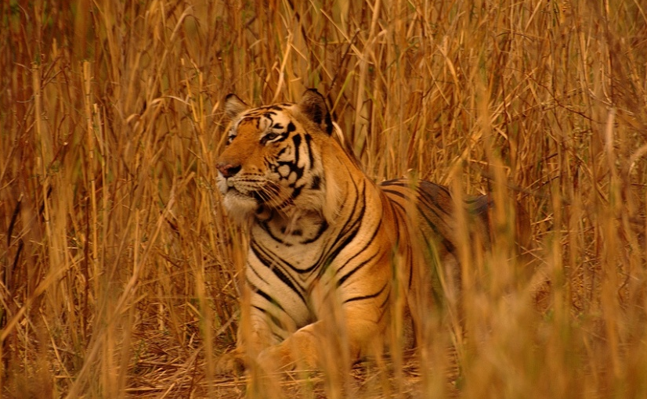
Adaption of XCS to Multi-Learner Predator/Prey Scenarios
Clemens Lode, Urban Richter, Hartmut Schmeck,
Karlsruhe Institute of Technology (Germany)

Slide 2
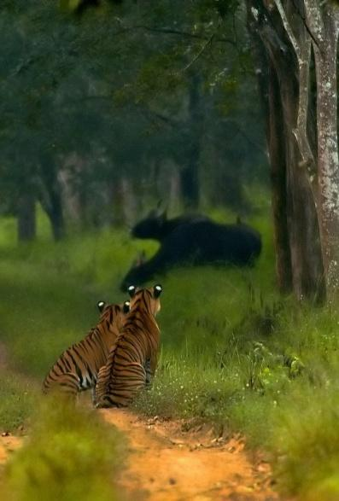
Adaption of XCS to Multi-Learner Predator/Prey Scenarios
Abstract:
Adaption of the multi-step approach of eXtended Classifier Systems to dynamic predator/prey scenarios by expanding the reward function to include sensory information and recording and analyzing the history of rewards and actions
http://www.flickr.com/photos/james_crowley

Slide 3
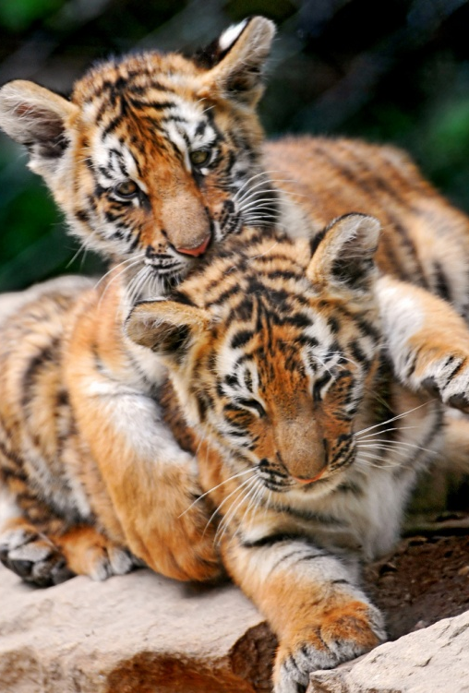
Outline (1)
1. Learning Classifier Systems:
Introduction and Terminology
Single-Step vs. Multi-Step Problems
Markov/Non Markov Environments
2. Predator/Prey Scenarios:
Introduction
Classification
http://www.flickr.com/photos/tambako

Slide 4

Outline (1)
1. Learning Classifier Systems:
Introduction and Terminology
Single-Step vs. Multi-Step Problems
Markov/Non Markov Environments
2. Predator/Prey Scenarios:
Introduction
Classification
http://www.flickr.com/photos/yathin

Slide 5
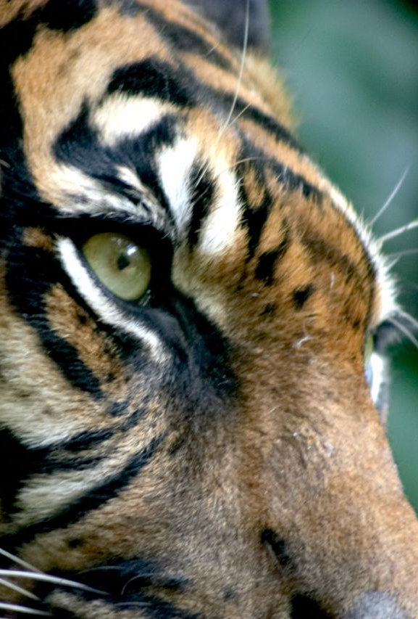
Outline (2)
3. Sensors and Reward:
Sensory Abilities of an Agent
Reward from the Environment
Reward Events
Reward Distribution
http://www.flickr.com/photos/mortalcoil/

Slide 6
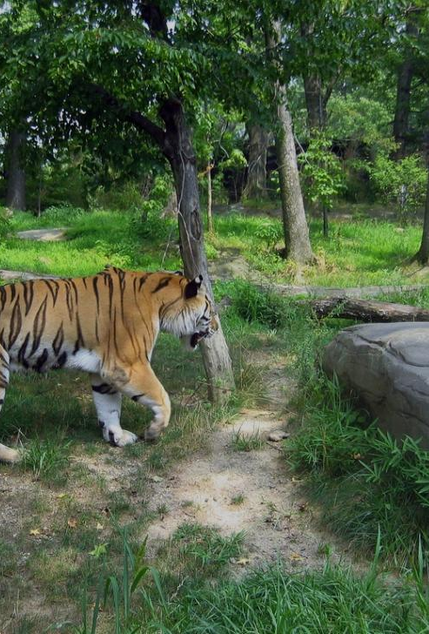
Outline (3)
4. Testing Methodology:
XCS Variants
Scenario Settings
Scenario Configurations
5. Experimental Results:
XCS Parameters
Comparison between standard XCS and event-based XCS
http://www.flickr.com/photos/james_crowley

Slide 7
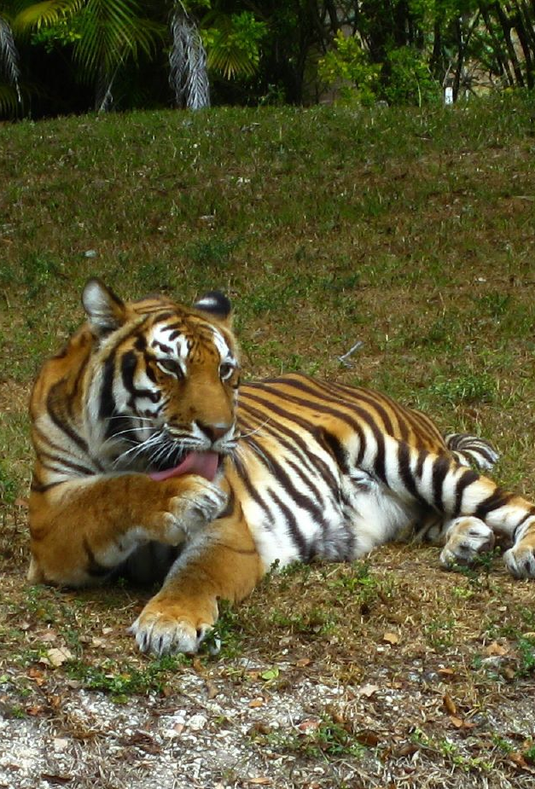
Outline (3)
4. Testing Methodology:
XCS Variants
Scenario Settings
Scenario Configurations
5. Experimental Results:
XCS Parameters
Comparison between the XCS variants
http://www.flickr.com/photos/readontheroad

Slide 8
1. Learning Classifier Systems
1. Learning Classifier Systems:
Introduction and Terminology
Single-Step vs. Multi-Step Problems
Markov/Non Markov Environments
2. Predator/Prey Scenarios:
General Introduction
Selected scenario
Classification

Slide 9
1. Learning Classifier Systems
Terminology:
Classifier: condition/action pair
Condition: Usually an array of bits including wild cards
Action: The “result” (e.g. movement command)
Match set: Set of classifiers whose condition match the sensory input
Action set: Sub set of the match set whose classifiers share a certain action value
Condition | Action
100110 | North
1001#0 | North
0##### | North
1001## | East
1011## | East
0011## | South
#####1 | West
##1### | West
##111# | West

Slide 10
1. Learning Classifier Systems
Terminology:
Classifier: condition/action pair
Condition: Usually an array of bits including wild cards
Action: The “result” (e.g. movement command)
Match set: Set of classifiers whose condition match the sensory input
Action set: Sub set of the match set whose classifiers share a certain action value
Condition | Action
100110 | North
1001#0 | North
0##### | North
1001## | East
1011## | East
0011## | South
#####1 | West
##1### | West
##111# | West

Slide 11
1. Learning Classifier Systems
Terminology:
Classifier: condition/action pair
Condition: Usually an array of bits including wild cards
Action: The “result” (e.g. movement command)
Match set: Set of classifiers whose condition match the sensory input
Action set: Sub set of the match set whose classifiers share a certain action value
Condition | Action
100110 | North
1001#0 | North
0##### | North
1001## | East
1011## | East
0011## | South
#####1 | West
##1### | West
##111# | West
100100
100101
100110
100111

Slide 12
1. Learning Classifier Systems
Terminology:
Classifier: condition/action pair
Condition: Usually an array of bits including wild cards
Action: The “result” (e.g. movement command)
Match set: Set of classifiers whose condition match the sensory input
Action set: Sub set of the match set whose classifiers share a certain action value
Condition | Action
100110 | North
1001#0 | North
0##### | North
1001## | East
1011## | East
0011## | South
#####1 | West
##1### | West
##111# | West

Slide 13
1. Learning Classifier Systems
Terminology:
Classifier: condition/action pair
Condition: Usually an array of bits including wild cards
Action: The “result” (e.g. movement command)
Match set: Set of classifiers whose condition match the sensory input
Action set: Sub set of the match set whose classifiers share a certain action value
Condition | Action
100110 | North
1001#0 | North
0##### | North
1001## | East
1011## | East
0011## | South
#####1 | West
##1### | West
##111# | West
001110

Slide 14
1. Learning Classifier Systems
Terminology:
Classifier: condition/action pair
Condition: Usually an array of bits including wild cards
Action: The “result” (e.g. movement command)
Match set: Set of classifiers whose condition match the sensory input
Action set: Sub set of the match set whose classifiers share a certain action value
Condition | Action
100110 | North
1001#0 | North
0##### | North
1001## | East
1011## | East
0011## | South
#####1 | West
##1### | West
##111# | West
001110, West

Slide 15
1. Learning Classifier Systems
Generation of classifiers:
Unknown input
Crossover and Mutation
Selection of classifiers
Random
Best Selection
Roulette Wheel Selection
Tournament Selection
Condition | Action
100110 | North
1001#0 | North
0##### | North
1001## | East
1011## | East
0011## | South
#####1 | West
##1### | West
##111# | West
?
100000

Slide 16
1. Learning Classifier Systems
Condition | Action
100110 | North
1001#0 | North
0##### | North
1001## | East
1011## | East
0011## | South
#####1 | West
##1### | West
##111# | West
1000#0 | North
10000# | East
1##000 | South
##0000 | West
Generation of classifiers:
Unknown input
Crossover and Mutation
Selection of classifiers
Random
Best Selection
Roulette Wheel Selection
Tournament Selection
100000

Slide 17
1. Learning Classifier Systems
Generation of classifiers:
Unknown input
Crossover and Mutation
Selection of classifiers
Random
Best Selection
Roulette Wheel Selection
Tournament Selection
Condition | Action | Fitness
100110 | North | 0.7
1001#0 | North | 0.2
0##### | North | 0.4
1001## | East | 0.5
1011## | East | 0.5
0011## | South | 0.1
#####1 | West | 0.3
##1### | West | 0.2
##111# | West | 0.3

Slide 18
1. Learning Classifier Systems
Generation of classifiers:
Unknown input
Crossover and Mutation
Selection of classifiers
Random
Best Selection
Roulette Wheel Selection
Tournament Selection
Condition | Action | Fitness
100110 | North | 0.7
1001#0 | North | 0.2
0##### | North | 0.4
1001## | East | 0.5
1011## | East | 0.5
0011## | South | 0.1
#####1 | West | 0.3
##1### | West | 0.2
##111# | West | 0.3
001110

Slide 19
1. Learning Classifier Systems
Generation of classifiers:
Unknown input
Crossover and Mutation
Selection of classifiers
Random
Best Selection
Roulette Wheel Selection
Tournament Selection
Condition | Action | Fitness
100110 | North | 0.7
1001#0 | North | 0.2
0##### | North | 0.4
1001## | East | 0.5
1011## | East | 0.5
0011## | South | 0.1
#####1 | West | 0.3
##1### | West | 0.2
##111# | West | 0.3
33%
33%
33%
001110

Slide 20
1. Learning Classifier Systems
Generation of classifiers:
Unknown input
Crossover and Mutation
Selection of classifiers
Random
Best Selection
Roulette Wheel Selection
Tournament Selection
Condition | Action | Fitness
100110 | North | 0.7
1001#0 | North | 0.2
0##### | North | 0.4
1001## | East | 0.5
1011## | East | 0.5
0011## | South | 0.1
#####1 | West | 0.3
##1### | West | 0.2
##111# | West | 0.3
100%
001110

Slide 21
1. Learning Classifier Systems
Generation of classifiers:
Unknown input
Crossover and Mutation
Selection of classifiers
Random
Best Selection
Roulette Wheel Selection
Tournament Selection
Condition | Action | Fitness
100110 | North | 0.7
1001#0 | North | 0.2
0##### | North | 0.4
1001## | East | 0.5
1011## | East | 0.5
0011## | South | 0.1
#####1 | West | 0.3
##1### | West | 0.2
##111# | West | 0.3
40%
10%
50%
001110

Slide 22
1. Learning Classifier Systems
Generation of classifiers:
Unknown input
Crossover and Mutation
Selection of classifiers
Random
Best Selection
Roulette Wheel Selection
Tournament Selection
Condition | Action | Fitness
100110 | North | 0.7
1001#0 | North | 0.2
0##### | North | 0.4
1001## | East | 0.5
1011## | East | 0.5
0011## | South | 0.1
#####1 | West | 0.3
##1### | West | 0.2
##111# | West | 0.3
84%
3%
13%
001110

Slide 23
1. Learning Classifier Systems Single- vs Multi-step Problems
Single-step problem
Multi-step problem
Non-observable Markov Decision Processes
Quality of solution immediately known
Global information is directly available
E.g. 6-Multiplexer

Slide 24
1. Learning Classifier Systems Single- vs Multi-step Problems
Single-step problem
Multi-step problem
Non-observable Markov Decision Processes
Wood1,Wood2
Partially observable Markov decision process (POMDP)
Environment is static
Global information can be reconstructed
Use memory for aliasing positions

Slide 25
1. Learning Classifier Systems Single- vs Multi-step Problems
Single-step problem
Multi-step problem
Non-observable Markov Decision Processes
Non-observable Markov Decision Processes
Impossible to reconstruct global information, even with memory
Focus of this paper

Slide 26
2. Predator/Prey Scenarios
1. Learning Classifier Systems:
Introduction and Terminology
Single-Step vs. Multi-Step Problems
Markov/Non Markov Environments
2. Predator/Prey Scenarios:
General Introduction
Selected scenario
Classification

Slide 27
2. Predator/Prey Scenarios
Predator/Prey Scenarios:
General Introduction
Selected scenario
Classification
Multi-Agent scenario
Predators and Prey move in four directions
Predators follow a capturing strategy
Prey moves faster than predators
Collaborative effort is required

Slide 28
2. Predator/Prey Scenarios
Predator/Prey Scenarios:
General Introduction
Selected scenario
Cooperative observation task:
Classification
Access to local information only
open areas with randomly places obstacles
internal state unknown to others
dynamic scenario
predators share global observation task
runs continuously

Slide 29
2. Predator/Prey Scenarios
Predator/Prey Scenarios:
General Introduction
Selected scenario
Classification
No MDP
Limited sensors (1, 3)
Aliasing positions (2)
No POMDP
Non-static scenario (4)
→ Selected Predator/Prey Scenario is NOMDP

Slide 30
3. Sensors and Reward
3. Sensors and Environment:
Sensory Abilities of an Agent
Reward from the Environment
Reward Events
Reward Distribution
http://www.flickr.com/photos/mortalcoil/

Slide 31
3. Sensors and Reward
Sensory Abilities of an Agent
Overview
Sight Range
Observation Range
Example
Sensors can distinguish between Predators, Prey and Obstacles
Sensors can be blocked
8 sensor-pairs per Agent
Sensor-pairs can determine distance (observation range, sight range, not visible)

Slide 32
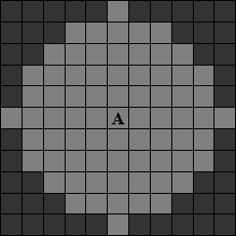
3. Sensors and Reward
Sensory Abilities of an Agent
Overview
Sight Range
Observation Range
Example
5 fields range:

Slide 33

3. Sensors and Reward
Sensory Abilities of an Agent
Overview
Sight Range
Observation Range
Example
2 fields range
Goal: Getting prey in observation range

Slide 34
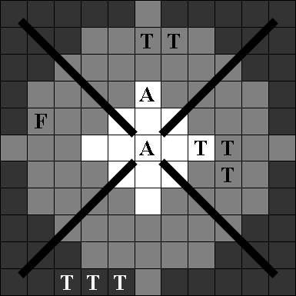
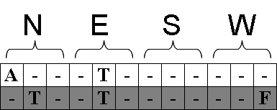
3. Sensors and Reward
Sensory Abilities of an Agent
Overview
Sight Range
Observation Range
Example

Slide 35
3. Sensors and Reward
Reward from the Environment

Slide 36
3. Sensors and Reward
Reward Events

Slide 37
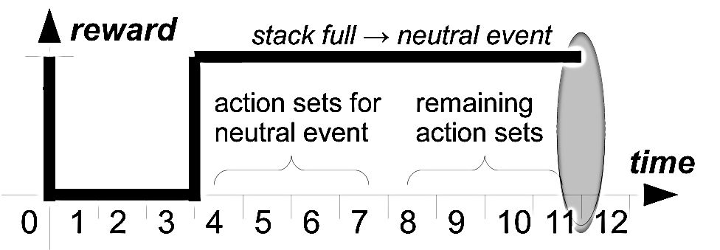
3. Sensors and Reward
Reward Events

Slide 38
3. Sensors and Reward
Reward Distribution

Slide 39
4. Testing Methodology
4. Testing Methodology:
XCS Variants
Scenario Settings
Scenario Configurations
5. Experimental Results:
XCS Parameters
Comparison between standard XCS and event-based XCS

Slide 40
4. Testing Methodology
XCS Variants
XCS (obs)
XCS (sight)
eventXCS
Scenario Settings
Scenario Configurations
Pillar Scenario
Random Scenario
Difficult Scenario
Standard implementation of XCS
For reward:
prey: only use observation range
Ignore other predators

Slide 41
4. Testing Methodology
XCS Variants
XCS (obs)
XCS (sight)
eventXCS
Scenario Settings
Scenario Configurations
Pillar Scenario
Random Scenario
Difficult Scenario
Standard implementation of XCS
For reward:
prey: use sight range
Ignore other predators

Slide 42
4. Testing Methodology
XCS Variants
XCS (obs)
XCS (sight)
eventXCS
Scenario Settings
Scenario Configurations
Pillar Scenario
Random Scenario
Difficult Scenario
XCS standard implementation with
event handling
reward distribution
For reward:
prey: use sight range
Ignore other predators

Slide 43
4. Testing Methodology
XCS Variants
Scenario Settings
Scenario Configurations
Pillar Scenario
Random Scenario
Difficult Scenario
Torus
16x16 fields
9 Agents
8 Predators
1 Prey
Number of Obstacles
Block sight and movement
→ Scenario Configuration

Slide 44
4. Testing Methodology
XCS Variants
Scenario Settings
Scenario Configurations
Pillar Scenario
Random Scenario
Difficult Scenario

Slide 45
4. Testing Methodology
XCS Variants
Scenario Settings
Scenario Configurations
Pillar Scenario
Random Scenario
Difficult Scenario

Slide 46
4. Testing Methodology
XCS Variants
Scenario Settings
Scenario Configurations
Pillar Scenario
Random Scenario
Difficult Scenario

Slide 47
5. Experimental Results
4. Testing Methodology:
XCS Variants
Scenario Settings
Scenario Configurations
5. Experimental Results:
XCS Parameters
Comparison of XCS Variants

Slide 48
5. Experimental Results
XCS Parameters
maxStackSize
Pillar Scenario
Random Scenario
Difficult Scenario
Learning rate
Pillar Scenario
Random Scenario
Difficult Scenario

Slide 49
5. Experimental Results
XCS Parameters
maxStackSize
Pillar Scenario
Random Scenario
Difficult Scenario
Learning rate
Pillar Scenario
Random Scenario
Difficult Scenario

Slide 50
5. Experimental Results
XCS Parameters
maxStackSize
Pillar Scenario
Random Scenario
Difficult Scenario
Learning rate
Pillar Scenario
Random Scenario
Difficult Scenario

Slide 51
5. Experimental Results
XCS Parameters
maxStackSize
Pillar Scenario
Random Scenario
Difficult Scenario
Learning rate
Pillar Scenario
Obstacle-evading prey
Predator-evading prey
Random Scenario
Difficult Scenario

Slide 52
5. Experimental Results
XCS Parameters
maxStackSize
Pillar Scenario
Random Scenario
Difficult Scenario
Learning rate
Pillar Scenario
Obstacle-evading prey
Predator-evading prey
Random Scenario
Difficult Scenario

Slide 53
5. Experimental Results
XCS Parameters
maxStackSize
Pillar Scenario
Random Scenario
Difficult Scenario
Learning rate
Pillar Scenario
Random Scenario
Obstacle-evading prey
Predator-evading prey
Difficult Scenario

Slide 54
5. Experimental Results
XCS Parameters
maxStackSize
Pillar Scenario
Random Scenario
Difficult Scenario
Learning rate
Pillar Scenario
Random Scenario
Obstacle-evading prey
Predator-evading prey
Difficult Scenario

Slide 55
5. Experimental Results
XCS Parameters
maxStackSize
Pillar Scenario
Random Scenario
Difficult Scenario
Learning rate
Pillar Scenario
Random Scenario
Difficult Scenario
Blind prey

Slide 56
5. Experimental Results
Comparison of XCS Variants
Pillar Scenario
Obstacle-evading prey
Predator-evading prey
Random Scenario
Difficult Scenario

Slide 57
5. Experimental Results
Comparison of XCS Variants
Pillar Scenario
Obstacle-evading prey
Predator-evading prey
Random Scenario
Difficult Scenario

Slide 58
5. Experimental Results
Comparison of XCS Variants
Pillar Scenario
Random Scenario
Obstacle-evading prey
Predator-evading prey
Difficult Scenario

Slide 59
5. Experimental Results
Comparison of XCS Variants
Pillar Scenario
Random Scenario
Obstacle-evading prey
Predator-evading prey
Difficult Scenario

Slide 60
5. Experimental Results
Comparison of XCS Variants
Pillar Scenario
Random Scenario
Difficult Scenario
Blinded prey

Slide 61
Recap (1)
1. Learning Classifier Systems:
Introduction and Terminology
Single-Step vs. Multi-Step Problems
Markov/Non Markov Environments
2. Predator/Prey Scenarios:
Introduction
Classification
http://www.flickr.com/photos/tambako

Slide 62
Recap (1)
1. Learning Classifier Systems:
Introduction and Terminology
Single-Step vs. Multi-Step Problems
Markov/Non Markov Environments
2. Predator/Prey Scenarios:
Introduction
Classification
http://www.flickr.com/photos/yathin

Slide 63
Recap (2)
3. Sensors and Reward:
Sensory Abilities of an Agent
Reward from the Environment
Reward Events
Reward Distribution
http://www.flickr.com/photos/mortalcoil/

Slide 64
Recap (3)
4. Testing Methodology:
XCS Variants
Scenario Settings
Scenario Configurations
5. Experimental Results:
XCS Parameters
Comparison between standard XCS and event-based XCS
http://www.flickr.com/photos/james_crowley

Slide 65
Recap (3)
4. Testing Methodology:
XCS Variants
Scenario Settings
Scenario Configurations
5. Experimental Results:
XCS Parameters
Comparison between standard XCS and event-based XCS
http://www.flickr.com/photos/readontheroad

Slide 66
Adaption of XCS to Multi-Learner Predator/Prey Scenarios
Abstract:
Adaption of the multi-step approach of eXtended Classifier Systems to dynamic predator/prey scenarios by expanding the reward function to include sensory information and recording and analyzing the history of rewards and actions
Questions?

